Slide 1
Clustering

Slide 2
What if a datapoint is equally close to two centroids?
We need some deterministic tie breaking
If two centroids are equally close to the data point, prefer centroid with larger index.
But most termination conditions do not need tie-breaking rule.

Slide 3
Online Demo: K-Means
https://www.naftaliharris.com/blog/visualizing-k-means-clustering/

Slide 4
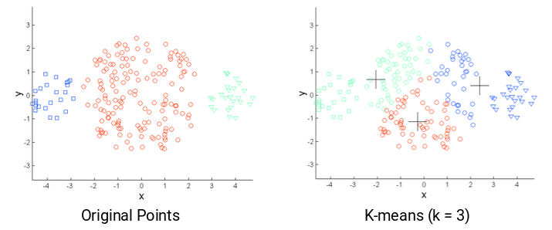
Challenges with K-means
If size of the clusters is different.

Slide 5
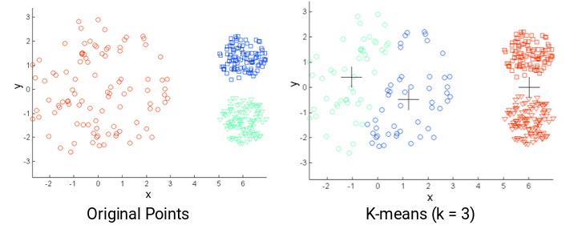
Challenges with K-means
If densities of the clusters is different.

Slide 6
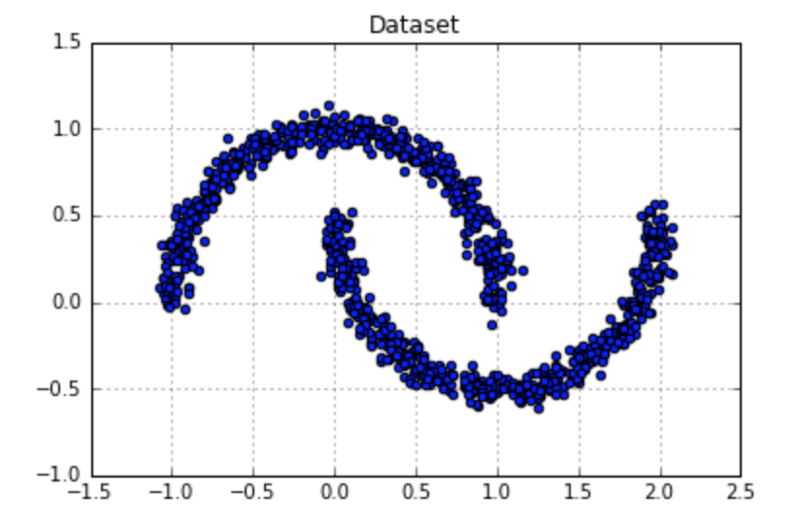
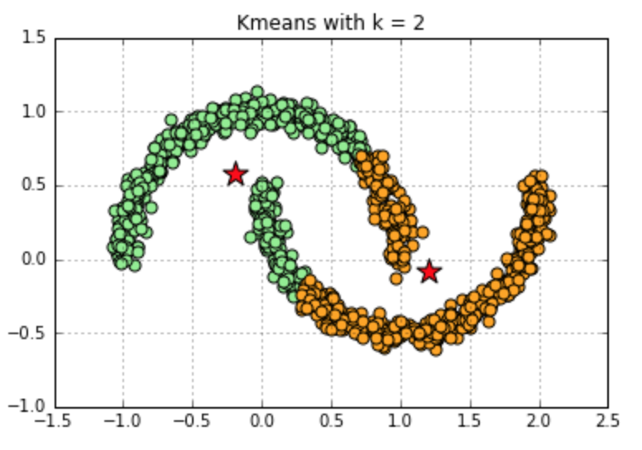
Challenges with K-means
If shape of the clusters is non-convex.
Note: K-means or DBSCAN are hard clustering algorithms. EM is soft clustering algorithms.
Solution: DBSAN or Expectation Maximization

Slide 7
Is K-means a great clustering algorithm?
No!
But it’s simplest clustering algorithm and it works in most of the cases
When is K-means a good clustering algorithm?
K-means tends to produce compact clusters of about equal size
K-means is optimal when the sought for clusters are spherical and of equal sizes

Slide 8
Alternatives to K-Means
In K-means, centroids are not data points. They are averages of datapoints.
Average is not an actual datapoint
One small change:
The centroids should be data points
K-Medoids
Compute average of a cluster just like before, but take centroid the closet actual element to the average from the data points
This is interpretable: For documents, we can take that medoid data point and say this is how an average document looks like within that cluster.

Slide 9
Alternatives to K-Means
Fuzzy K-means
Elements can belong to several clusters to varying degrees
Also referred to as soft clustering
EM-Algorithm (EM = Expectation-Maximization)
General-purpose optimization technique that can also be used for soft clustering
Works with different sizes and shapes of the data points
DBSCAN (Density Based Spatial Clustering of Applications with Noise)
Works by considering density of the data points and works with different sizes and shapes of the datapoints

Slide 10
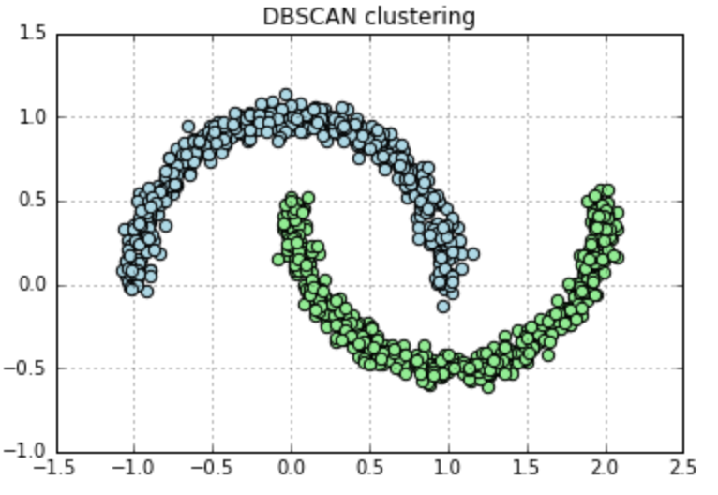
K-means VS DBSCAN

Slide 11
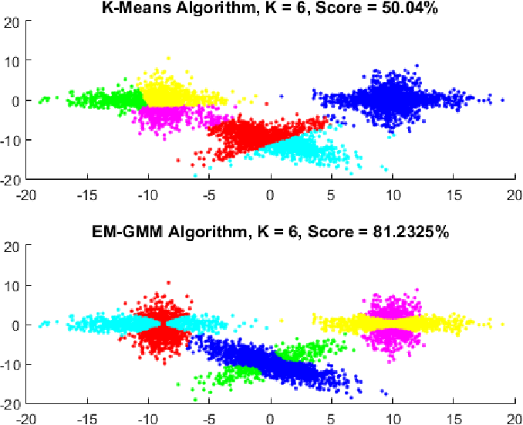
K-means VS EM

Slide 12
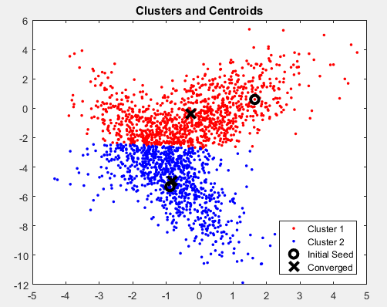
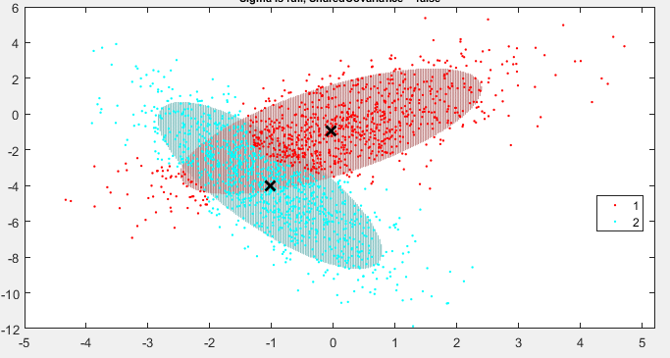
K-means VS EM

Slide 13
DBSCAN

Slide 14
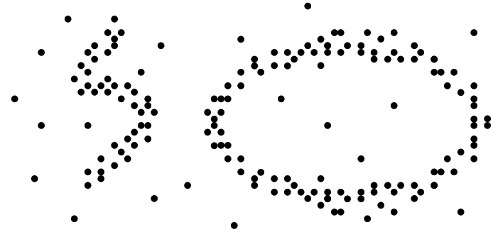
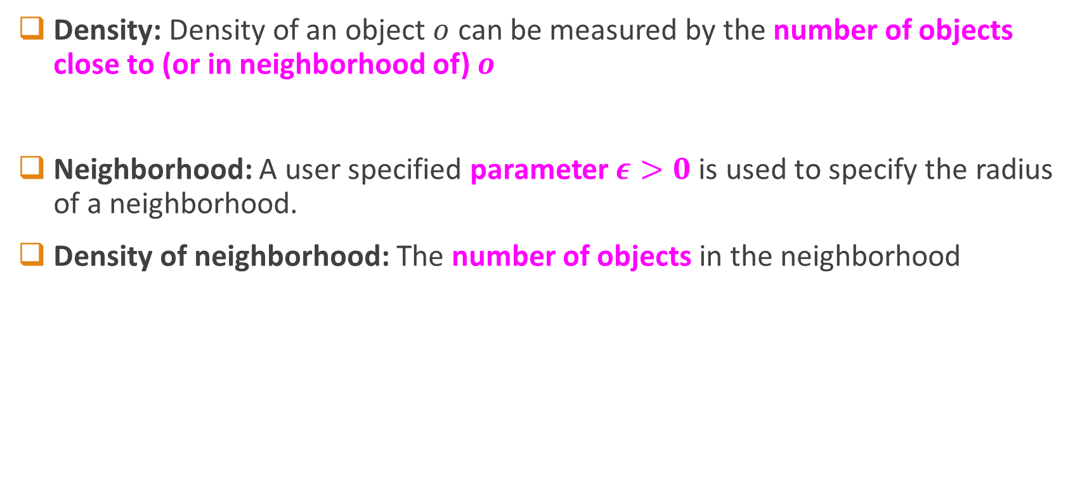
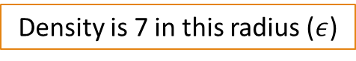
Basic Terms
Density: Density of an object $o$ can be measured by the number of objects close to (or in neighborhood of) $o$
Neighborhood: A user specified parameter $ε>0$ is used to specify the radius of a neighborhood.
Density of neighborhood: The number of objects in the neighborhood
Density is 7 in this radius ($ε$)

Slide 15
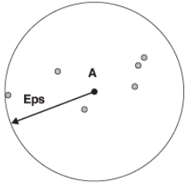
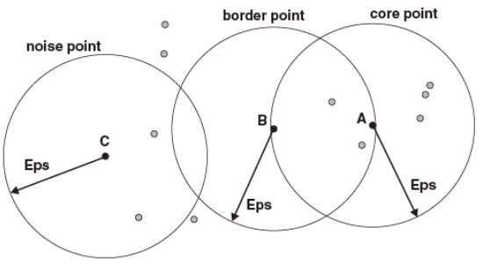
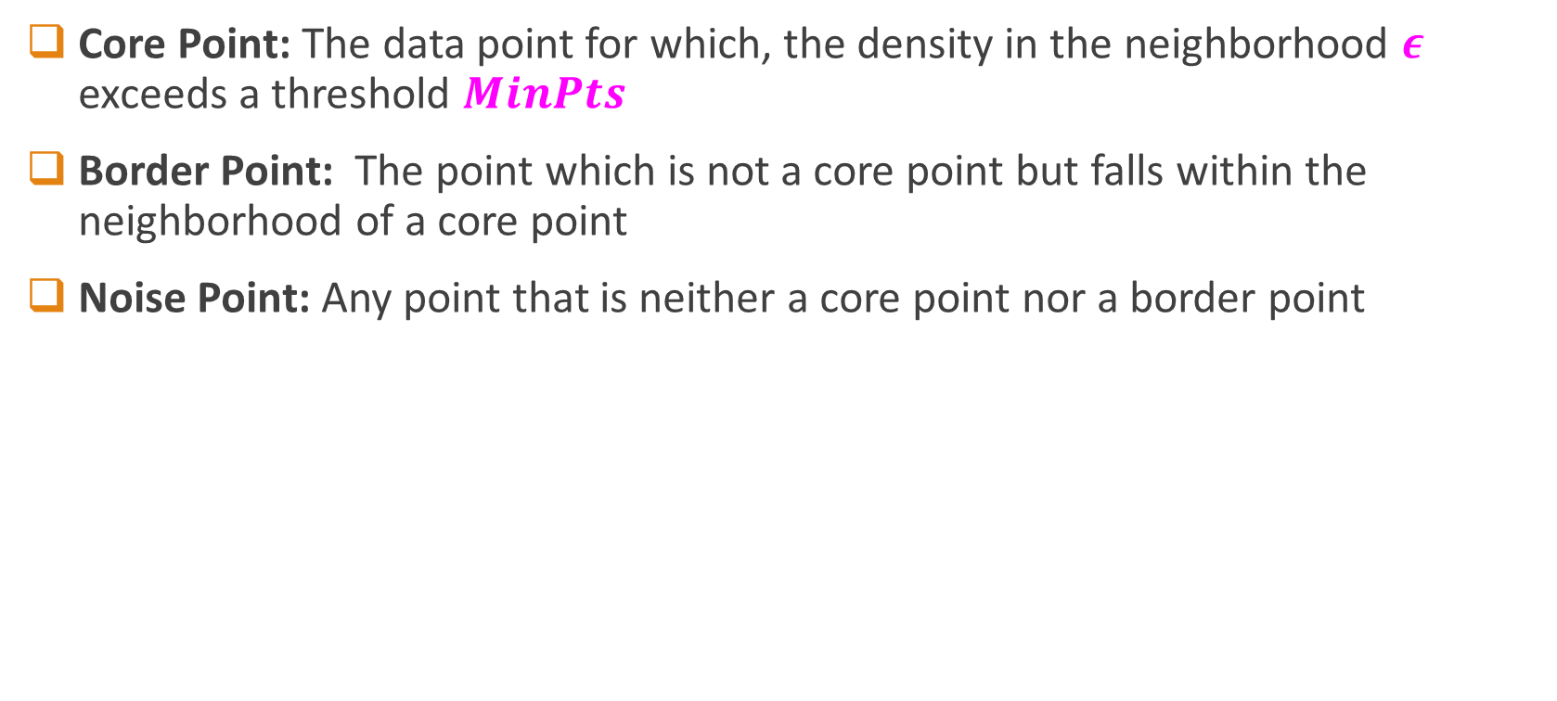
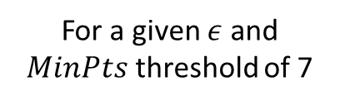
Basic Terms
Core Point: The data point for which, the density in the neighborhood $ε$ exceeds a threshold $MinPts$
Border Point: The point which is not a core point but falls within the neighborhood of a core point
Noise Point: Any point that is neither a core point nor a border point
For a given $ε$ and $MinPts$ threshold of 7

Slide 16
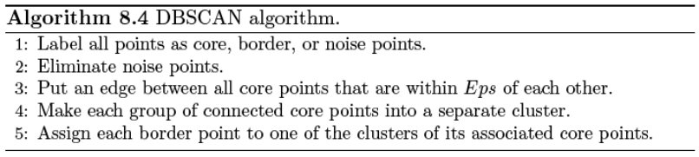
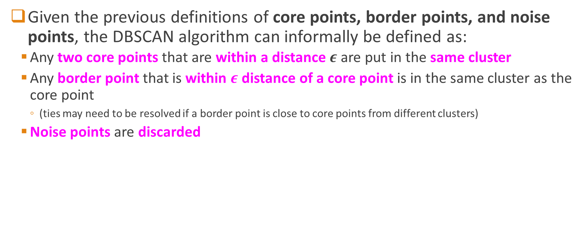
DBSCAN Algorithm
Given the previous definitions of core points, border points, and noise points, the DBSCAN algorithm can informally be defined as:
Any two core points that are within a distance $ε$ are put in the same cluster
Any border point that is within $ε$ distance of a core point is in the same cluster as the core point
(ties may need to be resolved if a border point is close to core points from different clusters)
Noise points are discarded

Slide 17
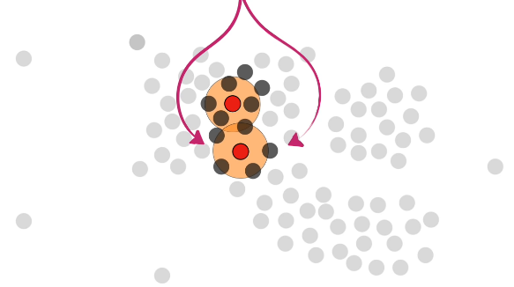
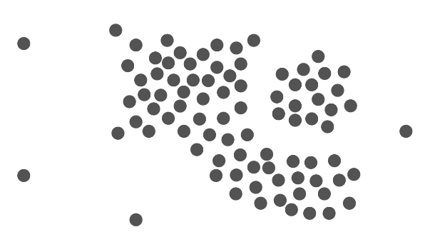
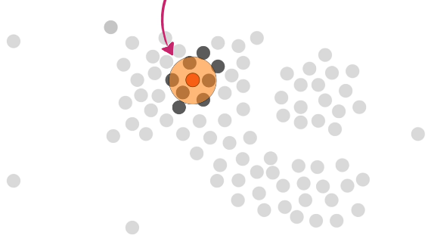
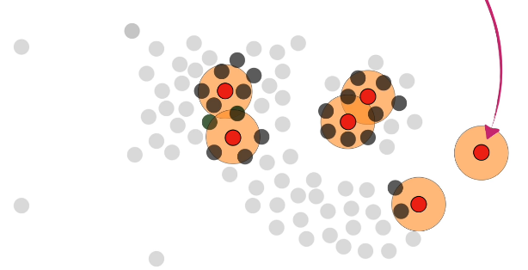

DBSCAN: Dry Run
How many points in the neighborhood of a data point?
A core point is then a point which has 4 or more points within a predefined radius.
$$MinPts = 4$$
Credit: StatQuest with Josh Stramer

Slide 18
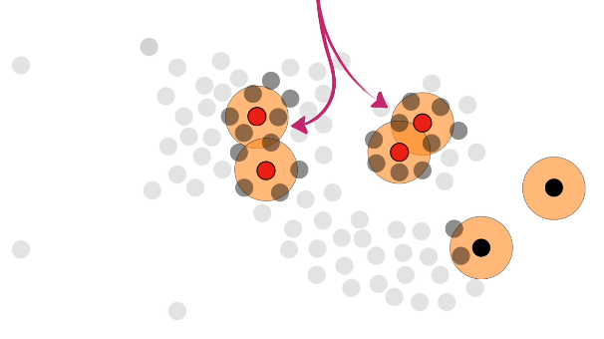
DBSCAN: Dry Run
Core Points
A core point is then a point which has 4 or more points within a predefined radius.
$$MinPts = 4$$
Credit: StatQuest with Josh Stramer

Slide 19
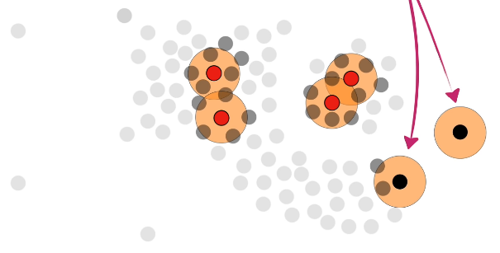
DBSCAN: Dry Run
Non-Core Points
A core point is then a point which has 4 or more points within a predefined radius.
$$MinPts = 4$$
Credit: StatQuest with Josh Stramer

Slide 20
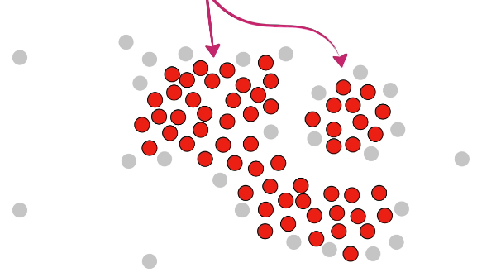
DBSCAN: Dry Run
Core Points
Eventually we will be able to identify all core points and non-core points
Credit: StatQuest with Josh Stramer

Slide 21
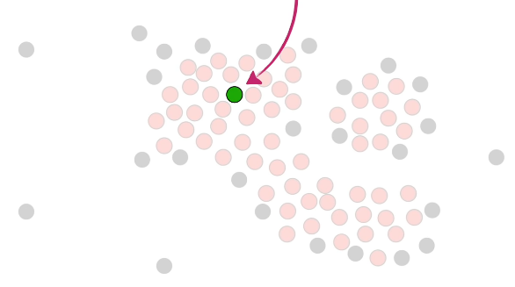
DBSCAN: Dry Run
Now start cluster assignment from a randomly selected core point
Credit: StatQuest with Josh Stramer

Slide 22
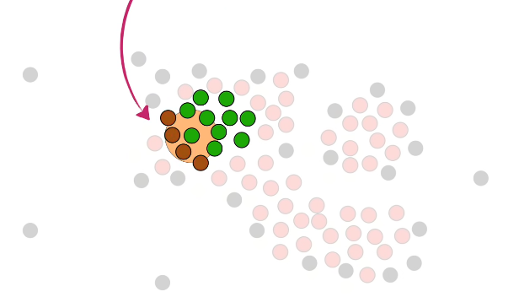
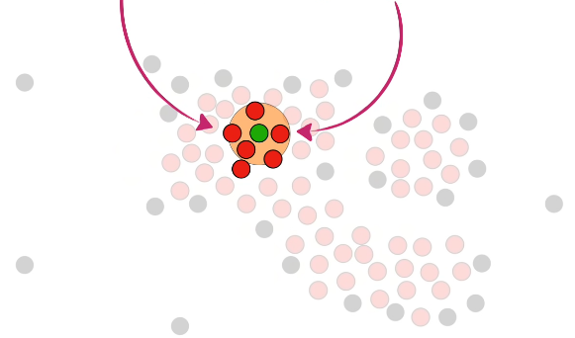
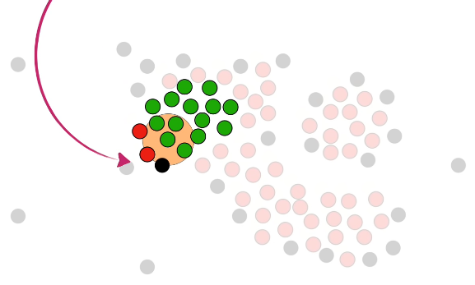
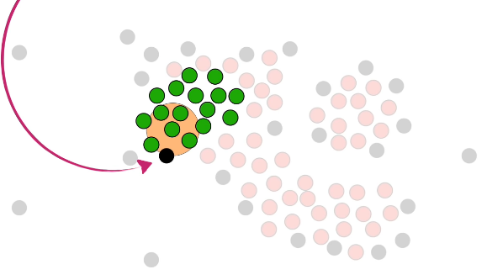
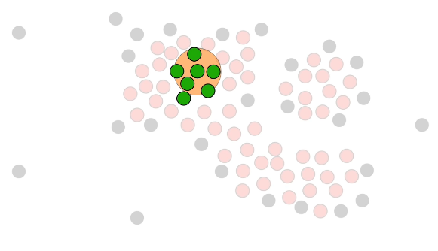
DBSCAN: Dry Run
Only core points are added to the cluster. Non-core points will be taken care of later.
Draw a circle around this cluster-assigned core point and see if there are any core points within that circle. If yes, add them to the same cluster.
Credit: StatQuest with Josh Stramer

Slide 23
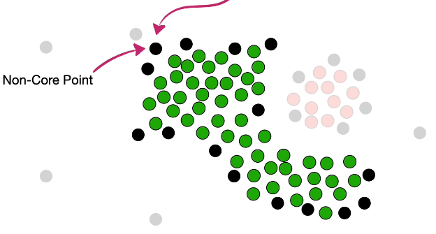
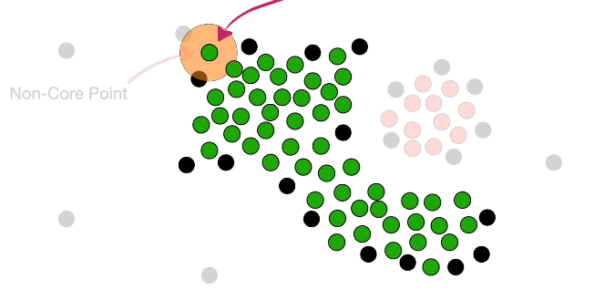
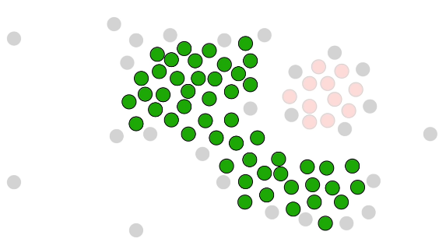
DBSCAN: Dry Run
Now let’s take care of non-core pints.
Eventually, all core points reachable from that initially randomly selected core point will be added to the cluster.
Credit: StatQuest with Josh Stramer

Slide 24
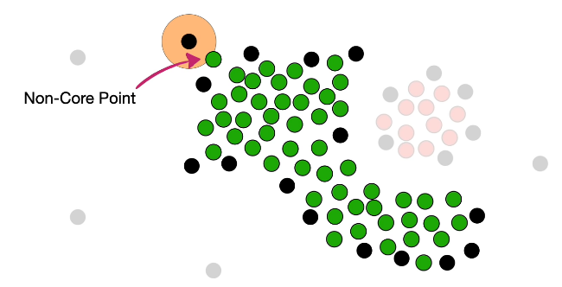
DBSCAN: Dry Run
This point cannot join the cluster as there are no core points within the radius of this point
Non-core points can only join a cluster if there are core points within the predefined radius ($ε$) from the non-core points.
Credit: StatQuest with Josh Stramer

Slide 25
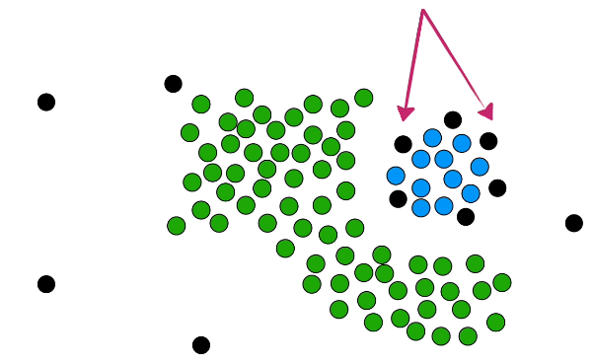
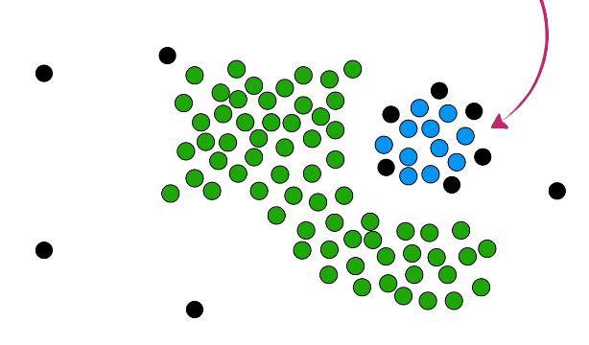
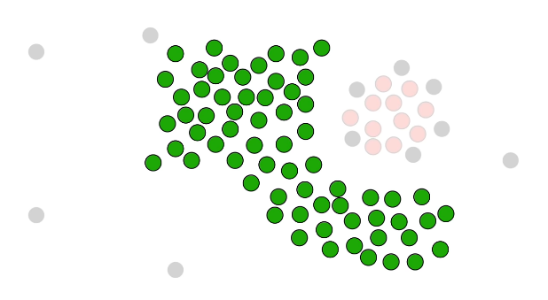
DBSCAN: Dry Run
Once all core-points are assigned to the cluster, assign non-core points also just like before…
Once all the non-core points are assigned to the cluster, we move to any other left over core-point but assign it to cluster 2 (as it was not reachable from any core point in cluster 1).
Credit: StatQuest with Josh Stramer

Slide 26
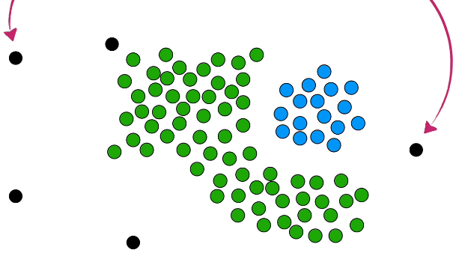
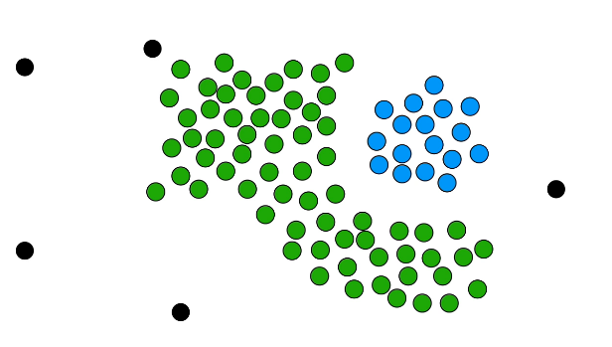
DBSCAN: Dry Run
Any remaining points which has no core-point in their neighbor, are outliers or noise points…
Once no core points are left, we are done clustering.
Credit: StatQuest with Josh Stramer

Slide 27
DBSCAN Algorithm: Advantages
Can cluster any shape
No need to specify number of clusters
Can find arbitrarily-shaped clusters
Robust to Outliers (noise)

Slide 28
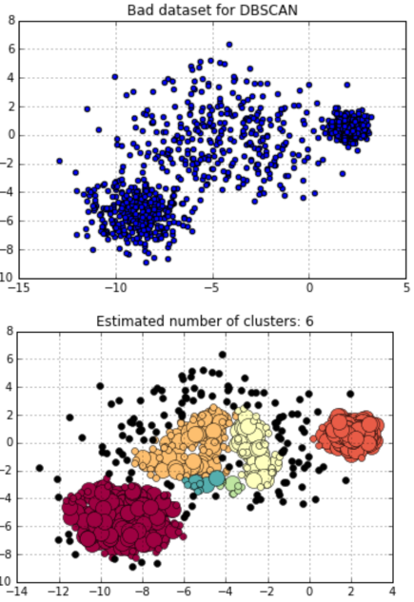
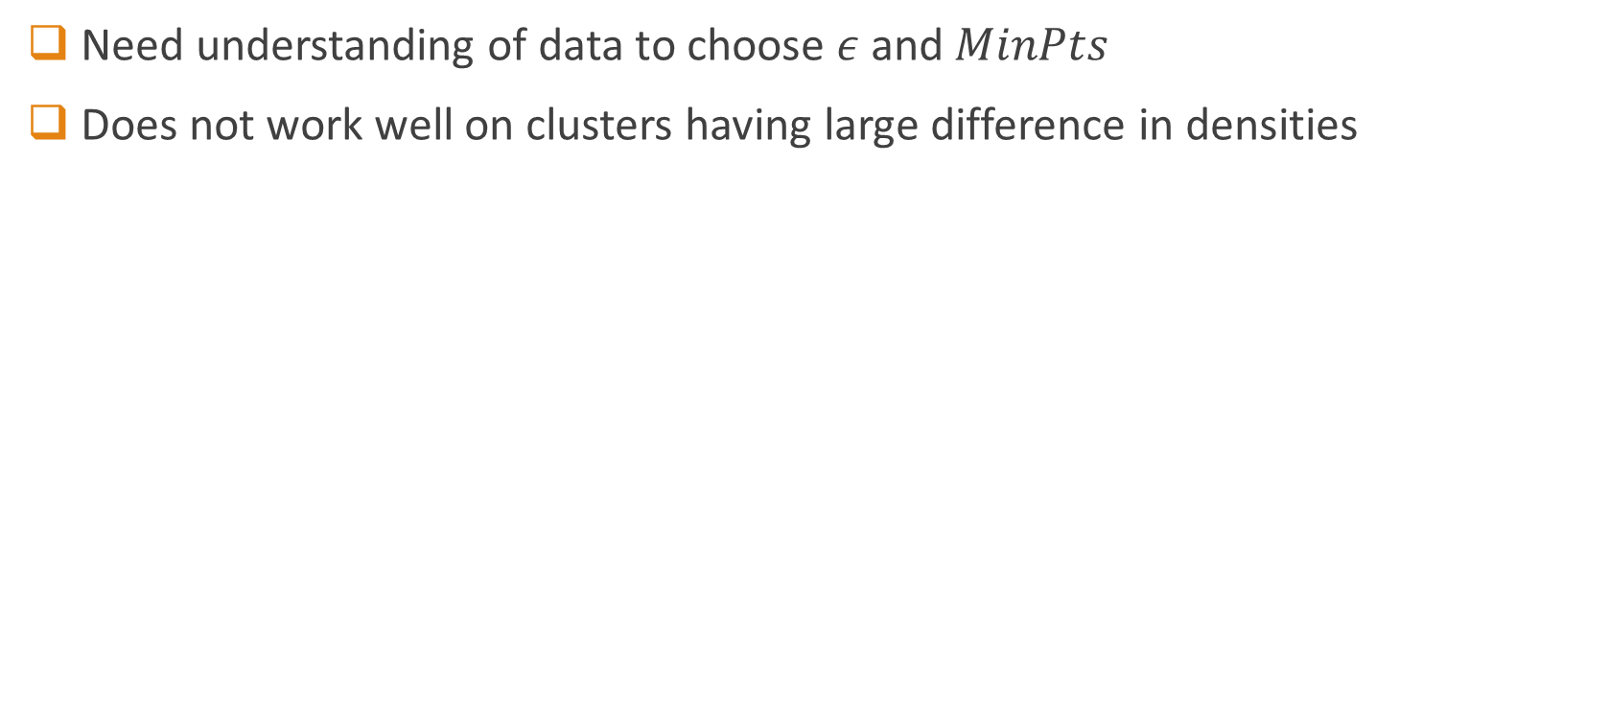
DBSCAN Algorithm: Disadvantages
Need understanding of data to choose $ε$ and $MinPts$
Does not work well on clusters having large difference in densities

Slide 29
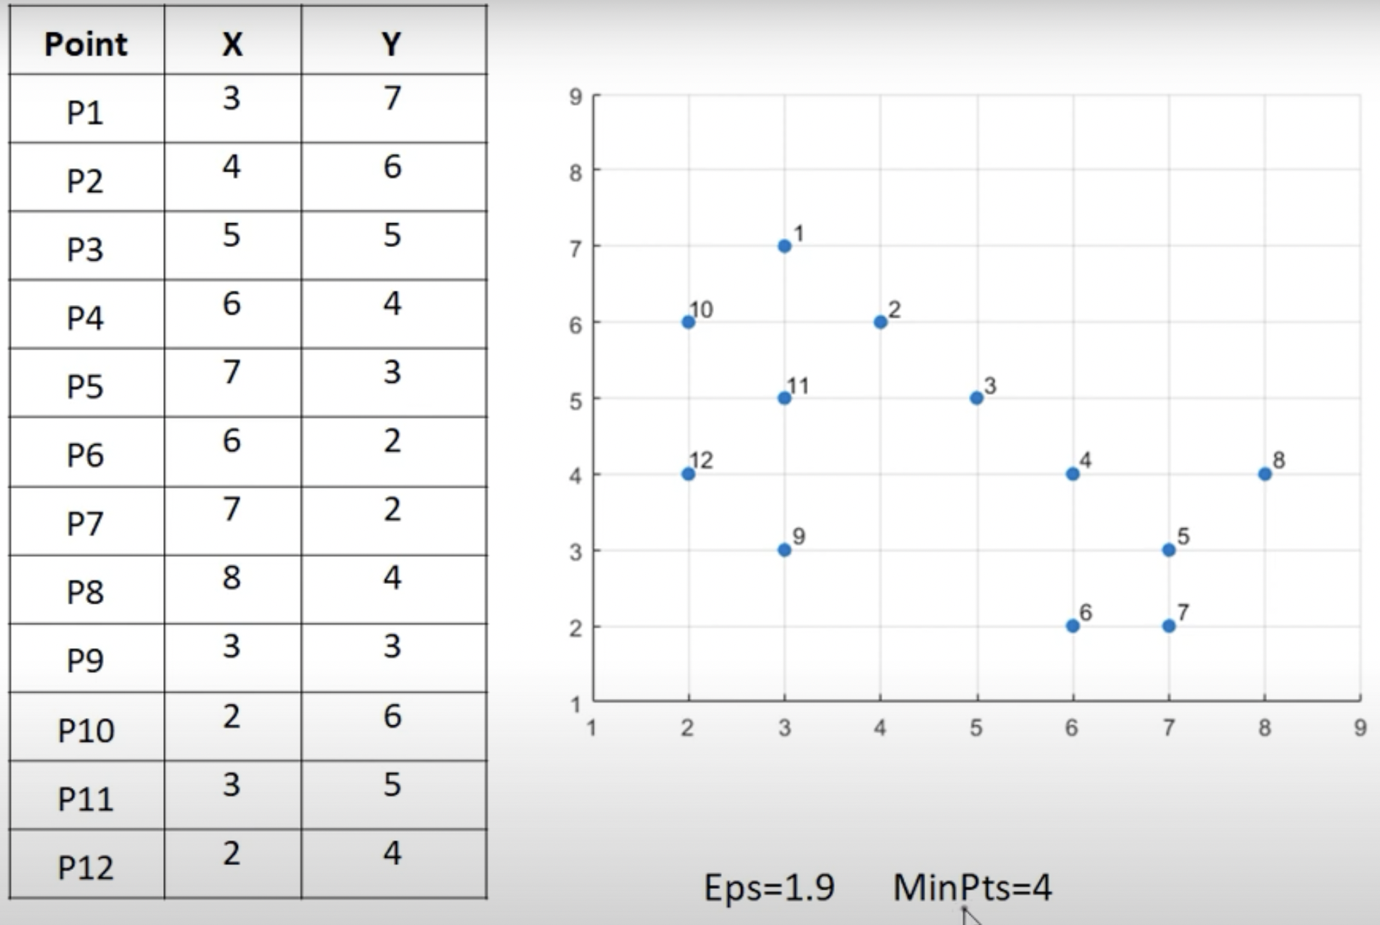
Example

Slide 30
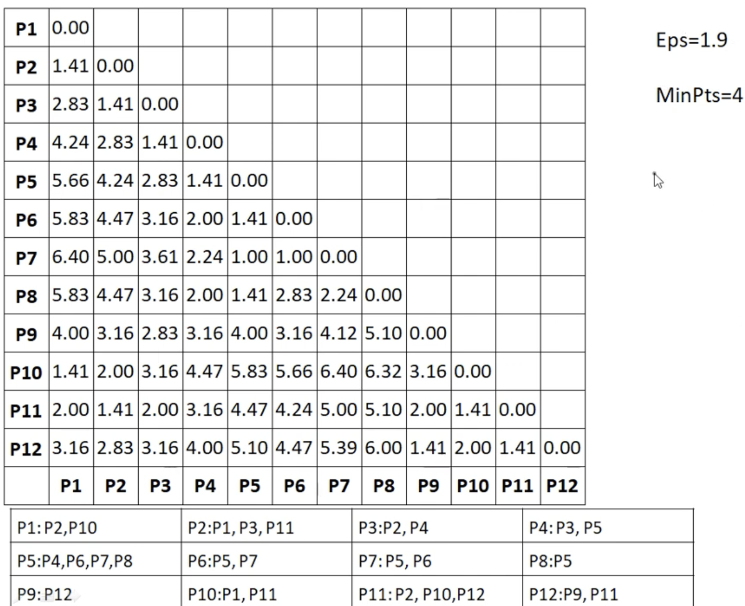

Slide 31
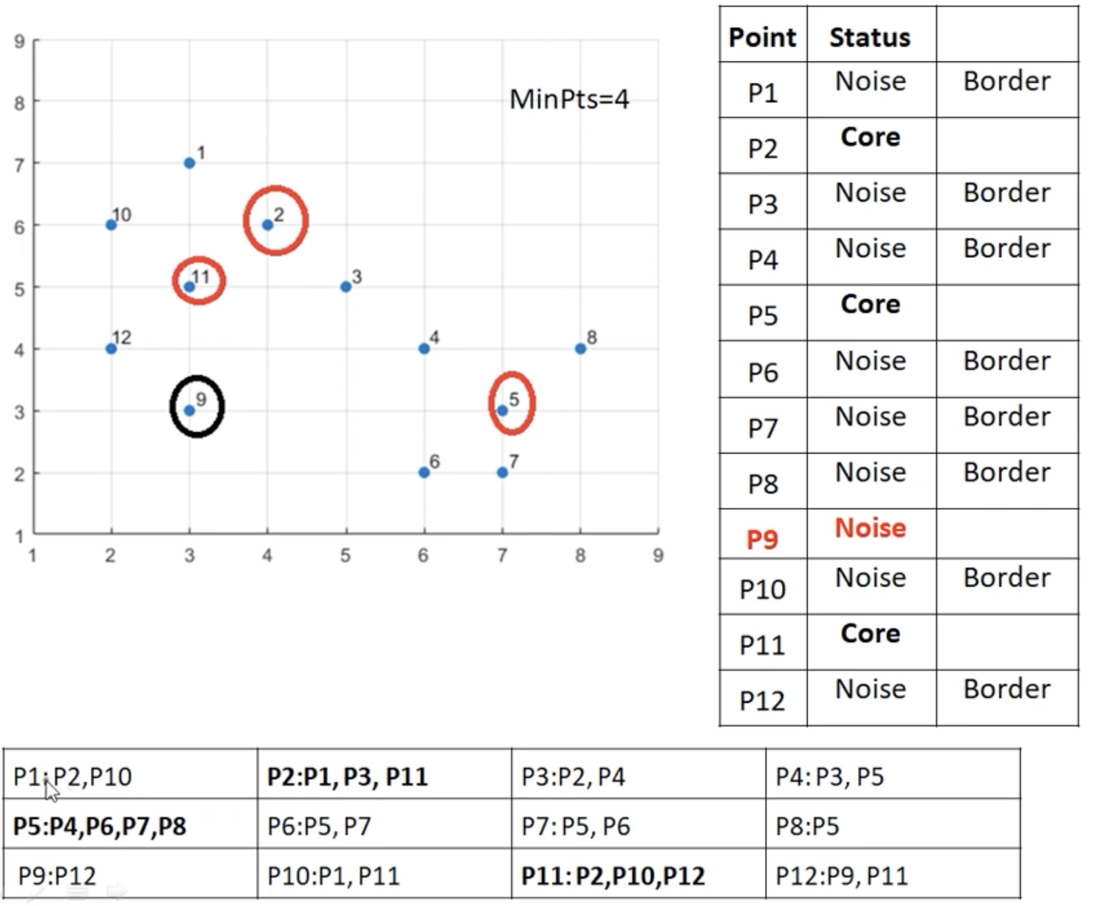

Slide 33
Online Demo: DBSCAN
https://www.naftaliharris.com/blog/visualizing-dbscan-clustering/

Slide 34
Reading
Blog: https://yanpuli.github.io/posts/2017/03/blog-post-8

